Slide 1
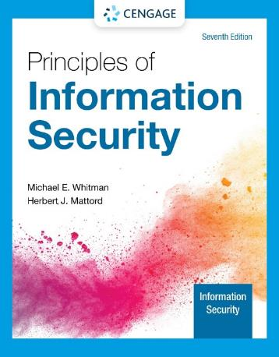
Module 1
Introduction to Information Security
Michael E. Whitman and Herbert J. Mattord, Principles of Information Security, 7th Edition. © 2022 Cengage. All Rights Reserved. May not be scanned, copied or duplicated, or posted to a publicly accessible website, in whole or in part.

Slide 2
Module Objectives
By the end of this module, you should be able to:
1.1 Define information security
1.2 Discuss the history of computer security and explain how it evolved into information security
1.3 Define key terms and critical concepts of information security
1.4 Describe the information security roles of professionals within an organization

Slide 3
Introduction
Every organization, whether public or private and regardless of size, has information it wants to protect.
Organizations have a responsibility to all their stakeholders to protect that information.
Unfortunately, there aren’t enough security professionals to go around.
If you’re not part of the solution, you’re part of the problem.

Slide 4
The History of Information Security
Computer security began immediately after the first mainframes were developed.
Groups developing code-breaking computations during World War II created the first modern computers.
Multiple levels of security were implemented to protect these devices.
During these early years, information security was a straightforward process composed predominantly of physical security and simple document classification schemes.
The primary threats to security were physical theft of equipment, espionage against products of the systems, and sabotage.
Notes:
Computer security began immediately after the first mainframes were developed.
Groups developing code-breaking computations during World War II created the first modern computers
Multiple levels of security were implemented
Physical controls to limit access to sensitive military locations to authorized personnel
Rudimentary in defending against physical theft, espionage, and sabotage

Slide 5
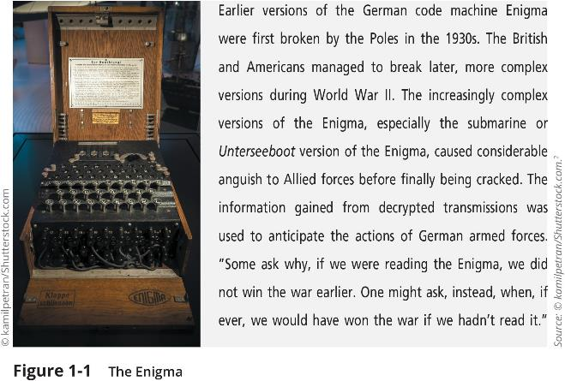
The Enigma
Notes:
Enigma (puzzle, mystery, dilemma)
This picture shows a high-visibility artifact associated with the early days of information security—focusing on the confidentiality of information. This artifact is also part of the study of cryptography from Chapter 8.

Slide 6
The 1960s
During the Cold War, many more mainframe computers were brought online to accomplish more complex and sophisticated tasks.
The Advanced Research Projects Agency (ARPA) began to examine the feasibility of a redundant networked communication system.
Larry Roberts led the development of the ARPANET, which evolved into what we now know as the Internet.
Notes:
During the 1960s, the Department of Defense’s Advanced Research Projects Agency (ARPA) began examining the feasibility of a redundant networked communications system designed to support the military’s need to exchange information.
Larry Roberts, known as the founder of the Internet, developed the project from its inception.

Slide 7
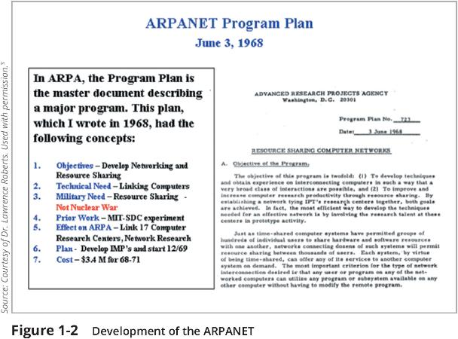
Development of the ARPANET
Notes:
Founding document from the ARPANET.

Slide 8
The 1970s and ’80s (1 of 2)
ARPANET grew in popularity, increasing the potential for misuse.
Fundamental problems with ARPANET security were identified.
Individual remote sites did not have sufficient controls and safeguards to protect data from unauthorized remote users.
Other problems included:
Vulnerability of password structure and formats
Lack of safety procedures for dial-up connections
Nonexistent user identification and authorizations
Notes:
ARPANET grew in popularity as did its potential for misuse
Fundamental problems with ARPANET security were identified
No safety procedures for dial-up connections to ARPANET
Nonexistent user identification and authorization to system
Late 1970s: microprocessor expanded computing capabilities and security threats

Slide 9
The 1970s and ’80s (2 of 2)
Information security began with RAND Report R-609—the paper that started the study of computer security and identified the role of management and policy issues in it‏.
The scope of computer security grew from physical security to include:
Securing the data
Limiting random and unauthorized access to data
Involving personnel from multiple levels of the organization in information security
Notes:
Information security began with Rand Report R-609 (paper that started the study of computer security and identified role of management and policy issues in it)‏
Scope of computer security grew from physical security to include:
Securing the data
Limiting random and unauthorized access to data
Involving personnel from multiple levels of the organization in information security

Slide 10
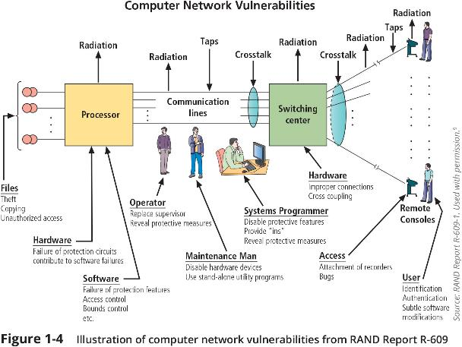
Computer Network Vulnerabilities

Slide 11
MULTICS
Early research on computer security research centered on a system called Multiplexed Information and Computing Service (MULTICS)‏.
The first operating system was created with security integrated into core functions.
Mainframe, time-sharing OS was developed in the mid-1960s by General Electric (GE), Bell Labs, and Massachusetts Institute of Technology (MIT)‏.
Several MULTICS key players created UNIX.
The primary purpose of UNIX was text processing.
Late 1970s: The microprocessor expanded computing capabilities and security threats.
Notes:
Early focus of computer security research centered on a system called Multiplexed Information and Computing Service (MULTICS)‏
First operating system created with security integrated into core functions
Mainframe, time-sharing OS developed in mid-1960s by General Electric (GE), Bell Labs, and Massachusetts Institute of Technology (MIT)‏
Several MULTICS key players created UNIX
Primary purpose of UNIX was text processing
Late 1970s: microprocessor expanded computing capabilities and security threats

Slide 12
The 1990s
Networks of computers became more common, as did the need to connect them to each other.
The Internet became the first global network of networks.
Initially, network connections were based on de facto standards (those which have been accepted as the best standard).
In early Internet deployments, security was treated as a low priority.
In the late 1990s and into the 2000s, many large corporations began publicly integrating security into their organizations.
Information security began to emerge as an independent discipline.
Notes:
Networks of computers became more common; so did the need to connect them to each other
Internet became first global network of networks
Initially based on de facto standards (best practice)
In early Internet deployments, security was treated as a low priority
In 1993, DEFCON conference established for those interested in information security

Slide 13
2000 to Present
The Internet brings millions of unsecured computer networks and billions of computer systems into continuous communication with each other.
The ability to secure a computer’s data was influenced by the security of every computer to which it is connected.
The growing threat of cyberattacks has increased the awareness of need for improved security.
The threat environment has grown from the semiprofessional hacker damaging Web sites for amusement to professional cybercriminals maximizing revenue from theft and extortion, as well as government-sponsored cyberwar groups striking military, government, and commercial targets.
Notes:
The Internet brings millions of unsecured computer networks into continuous communication with each other.
Ability to secure a computer’s data influenced by the security of every computer to which it is connected
Growing threat of cyberattacks has increased the awareness of need for improved security
Nation-states engaging in information warfare

Slide 14
Key Dates in Information Security (1 of 3)
Date | Document
1968 | Maurice Wilkes discusses password security in Time-Sharing Computer Systems.
1970 | Willis H. Ware authors the report "Security Controls for Computer Systems: Report of Defense Science Board Task Force on Computer Security-RAND Report R-609," which was not declassified until 1979. It became known as the seminal work identifying the need for computer security.
1973 | Schell, Downey, and Popek examine the need for additional security in military systems in Preliminary Notes on the Design of Secure Military Computer Systems.
1975 | The Federal Information Processing Standards (FIPS) examines DES (Digital Encryption Standard) in the Federal Register.
1978 | Bisbey and Hollingworth publish their study “Protection Analysis: Final Report," which discussed the Protection Analysis project created by ARPA to better understand the vulnerabilities of operating system security and examine the possibility of automated vulnerability detection techniques in existing system .

Slide 15
Key Dates in Information Security (2 of 3)
Date | Document
1979 | Morris and Thompson author “Password Security: A Case History," published in the Communications of the Association for Computing Machinery (ACM). The paper examined the design history of a password security scheme on a remotely accessed, time-sharing system. Dennis Ritchie publishes “On the Security of UNIX" and "Protection of Data File Contents," which discussed secure user IDs, secure group IDs, and the problems inherent in the systems.
1982 | The U.S. Department of Defense Computer Security Evaluation Center publishes the first version of the Trusted Computer Security (TCSEC) documents, which came to be known as the Rainbow Series.

Slide 16
Key Dates in Information Security (3 of 3)
Date | Document
1984 | Grampp and Morris write “The UNIX System: UNIX Operating System Security." In this report, the authors examined four "important handles to computer security": physical control of premises and computer facilities, management commitment to security objectives, education of employees, and administrative procedures aimed at increased security. Reeds and Weinberger publish “File Security and the UNIX System Crypt Command." Their premise was: “No technique can be secure against wiretapping or its equivalent on the computer. Therefore, no technique can be secure against the system administrator or other privileged users . . . the naive user has no chance.“
1992 | Researchers for the Internet Engineering Task Force, working at the Naval Research Laboratory, develop the Simple Internet Protocol Plus (SIPP) Security protocols, creating what is now known as IPSEC security.

Slide 17
What Is Security?
“A state of being secure and free from danger or harm; the actions taken to make someone or something secure.”
A successful organization should have multiple layers of security in place to protect:
Operations
Physical Infrastructure
People
Functions
Communications
Information
Notes:
“A state of being secure and free from danger or harm; the actions taken to make someone or something secure”
A successful organization should have multiple layers of security in place to protect:
Operations
Physical Infrastructure
People
Functions
Communications
Information

Slide 18
Information Security
InfoSec “The protection of information and its critical elements, including systems and hardware that use, store, and transmit that information” (CNSS).
InfoSec Includes information security management, data security, and network security.
CNSS, or Committee on National Security Systems, is a three-dimensional security model that has become a standard security model for many of today's computers and networks.
CNSS has three key security objectives: confidentiality, integrity, and availability.
C.I.A. triad (triplet) of Confidentiality, Integrity, and Availability:
Is a standard based on confidentiality, integrity, and availability, now viewed as inadequate.
Expanded model consists of a list of critical characteristics of information
Notes:
CNSS, or Committee on National Security Systems, is a three-dimensional security model that has become a standard security model for many of today's computers and networks. CNSS has three key security objectives: confidentiality, integrity, and availability.

Slide 19
Knowledge Check Activity 1
What is security?
Freedom from fear
Protection from loss
Keeping secrets
Being secure and free from danger

Slide 20
Knowledge Check Activity 1: Answer
What is security?
Answer: D. Being secure and free from danger
Only this answer is complete. Fear has little to do with security; many are fearful even when secure. Security does not mean losses cannot occur, just that they are planned for and survivable. Confidentiality (secrets) is just one of the three key aspects of security.

Slide 21
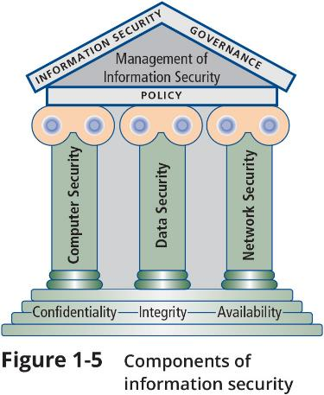
Components of Information Security

Slide 22
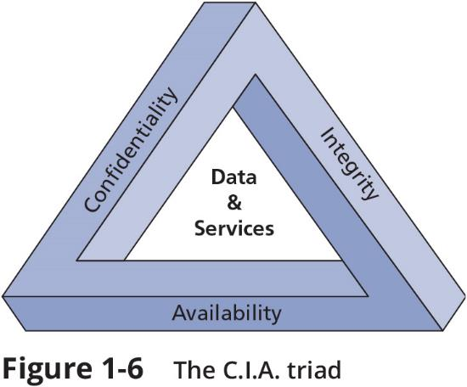
The C.I.A. Triad

Slide 23
Key Information Security Concepts
Access
Asset
Attack
Control, safeguard, or countermeasure
Exploit
Exposure
Loss
Protection profile or security posture
Risk
Subjects and objects
Threat
Threat agent
Threat event
Threat source
Vulnerability
Notes:
Access—a subject or object’s ability to use, manipulate, modify, or affect another subject or object.
Asset—the organizational resource that is being protected.
Attack—an intentional or unintentional act that can damage or otherwise compromise information and the systems that support it.
Control, safeguard, or countermeasure—Security mechanisms, policies, or procedures that can successfully counter attacks, reduce risk, resolve vulnerabilities, and otherwise improve security within an organization.
Exploit—a technique used to compromise a system.
Exposure—a condition or state of being exposed.
Loss—a single instance of an information asset suffering damage or destruction, unintended or unauthorized modification or disclosure, or denial of use.
Protection profile or security posture—entire set of controls and safeguards that the organization implements to protect the asset.
Risk—the probability of an unwanted occurrence.
Subjects and objects—a computer can be either an agent entity used to conduct an attack or the target entity.
Threat agent—the specific instance or a component of a threat.
Threat source—a category of objects, people, or other entities that represents a danger to an asset.
Vulnerability—weaknesses or faults in a system or protection mechanism that expose information to attack or damage.

Slide 24

Key Concepts
Access—a subject or object’s (e.g., user) ability to use, manipulate, modify, or affect another subject or object (e.g., data).
Asset—the organizational resource that is being protected such as information and systems that support it
Attack—an intentional or unintentional act that can damage or otherwise compromise information and the systems that support it.
Control, safeguard, or countermeasure—Security mechanisms, policies, or procedures that can successfully counter attacks, reduce risk, resolve vulnerabilities, and otherwise improve security within an organization.
Exploit—a technique used to compromise a system.
Exposure—a condition or state of being exposed.

Slide 25
Key Concepts
Loss—a single instance of an information asset suffering damage or destruction, unauthorized modification or disclosure, or denial of use.
Protection profile or security posture—entire set of controls and safeguards that the organization implements to protect the asset.
Risk—the probability of an unwanted occurrence.
Subjects and objects—a computer can be either an agent entity used to conduct an attack or the target entity.

Slide 26
Key Concepts
Threat- a danger to an asset
Threat agent—the specific instance or a component of a threat.
Threat source—a category of objects, people, or other entities that represents a danger to an asset.
Vulnerability—weaknesses or faults in a system or protection mechanism that expose information to attack or damage.

Slide 27
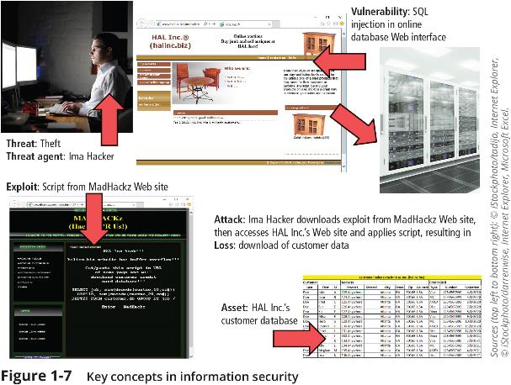
Key Concepts in Information Security

Slide 28
Critical Characteristics of Information
The value of information comes from the characteristics it possesses:
Confidentiality
Integrity
Availability
Accuracy
Authenticity
Utility
Possession
Notes:
The value of information comes from the characteristics it possesses.
Availability—Enables users who need to access information to do so without interference or obstruction and in the required format. The information is said to be available to an authorized user when and where needed and in the correct format.
Accuracy—Free from mistake or error and having the value that the end user expects. If information contains a value different from the user’s expectations due to the intentional or unintentional modification of its content, it is no longer accurate.
Authenticity—The quality or state of being genuine or original, rather than a reproduction or fabrication. Information is authentic when it is the information that was originally created, placed, stored, or transferred.
Confidentiality—The quality or state of preventing disclosure or exposure to unauthorized individuals or systems.
Integrity—The quality or state of being whole, complete, and uncorrupted. The integrity of information is threatened when the information is exposed to corruption, damage, destruction, or other disruption of its authentic state.
Utility—The quality or state of having value for some purpose or end. Information has value when it serves a particular purpose. This means that if information is available, but not in a format meaningful to the end user, it is not useful.
Possession—The quality or state of having ownership or control of some object or item. Information is said to be in possession if one obtains it, independent of format or other characteristic. While a breach of confidentiality always results in a breach of possession, a breach of possession does not always result in a breach of confidentiality.

Slide 29
Critical Characteristics of Information
Availability—Enables users who need to access information to do so without interference or obstruction and in the required format. The information is said to be available to an authorized user when and where needed and in the correct format.
Accuracy—Free from mistake or error and having the value that the end user expects. If information contains a value different from the user’s expectations due to the intentional or unintentional modification of its content, it is no longer accurate.
Authenticity—The quality or state of being genuine or original, rather than a reproduction or fabrication. Information is authentic when it is the information that was originally created, placed, stored, or transferred.

Slide 30

Critical Characteristics of Information
Confidentiality—The quality or state of preventing disclosure or exposure to unauthorized individuals or systems.
Integrity—The quality or state of being whole, complete, and uncorrupted. The integrity of information is threatened when the information is exposed to corruption, damage, destruction, or other disruption of its authentic state.
Utility—The quality or state of having value for some purpose or end. Information has value when it serves a particular purpose. This means that if information is available, but not in a format meaningful to the end user, it is not useful.
Possession—The quality or state of having ownership or control of some object or item. Information is said to be in possession if one obtains it, independent of format or other characteristic.
While a breach of confidentiality always results in a breach of possession, a breach of possession does not always result in a breach of confidentiality

Slide 31
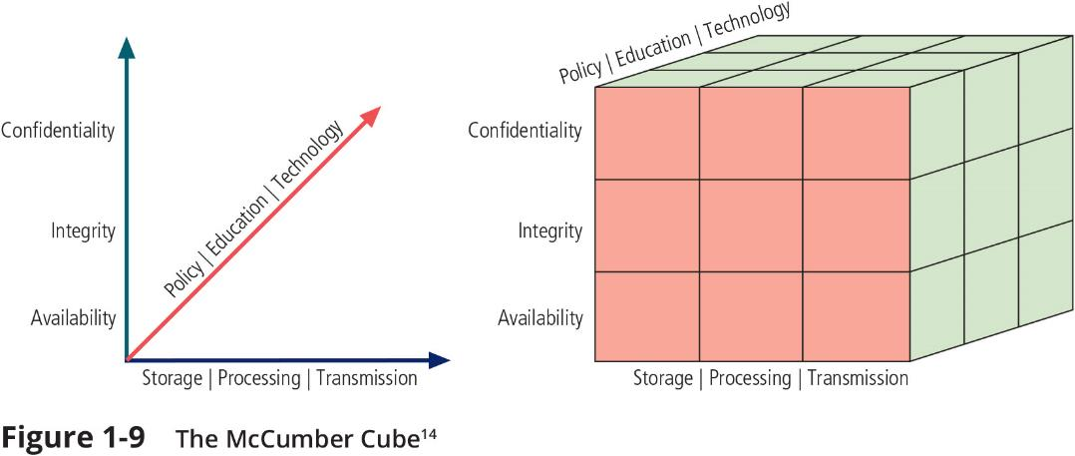
Committee on National Security Systems (CNSS) Security Model
Notes:
This graphic informs the fundamental approach of the chapter and can be used to illustrate the intersection of information states (x-axis), key objectives of C.I.A. (y-axis), and the three primary means to implement (policy, education, and technology).

Slide 32
Components of an Information System
An information system (IS) is the entire set of hardware, software data, people, procedures, and networks that enable a business to use information.
All of them work together to support personal and professional operations.
Each one has its own strengths and weaknesses, as well as its own characteristics and uses.
Each one has its own security requirements.
Notes:
An information system (IS) is entire set of people, procedures, and technology that enable business to use information.
Software
Hardware
Data
People
Procedures
Networks

Slide 33
Balancing Information Security and Access
It is impossible to obtain perfect information security—it is a process, not a goal.
Security should be considered a balance between protection and availability.
To achieve balance, the level of security must allow reasonable access, yet protect against threats.
Notes:
When considering information security, it is important to realize that it is impossible to obtain perfect security. Security is not an absolute; it is a process, not a goal.
Security should be considered a balance between protection and availability.
To achieve balance, the level of security must allow reasonable access, yet protect against threats.

Slide 34
Approaches to Information Security Implementation: Bottom-Up Approach
Grassroots effort: systems administrators work to improve security of their systems.
Key advantage: technical expertise of individual administrators
Seldom works, as it lacks a number of critical features:
Participant support
Organizational staying power
Notes:
Security can begin as a grassroots effort when systems administrators attempt to improve the security of their systems. This is referred to as the bottom-up approach.
The key advantage of the bottom-up approach is the technical expertise of the individual administrators.
Unfortunately, this approach seldom works, as it lacks a number of critical features, such as participant support and organizational staying power.

Slide 35
Approaches to Information Security Implementation: Top-Down Approach
Initiated by upper management
Issue policy, procedures, and processes
Dictate goals and expected outcomes of project
Determine accountability for each required action
The most successful type of top-down approach also involves a formal development strategy referred to as a systems development life cycle (SDLC).
Notes:
An alternative approach, which has a higher probability of success, is called the top-down approach. The project is initiated by upper management, who issue policies, procedures, and processes; dictate the goals and expected outcomes of the project; and determine who is accountable for each of the required actions.
The top-down approach has strong upper-management support, a dedicated champion, dedicated funding, clear planning, and the opportunity to influence organizational culture.
The most successful top-down approach also involves a formal development strategy referred to as a systems development life cycle.

Slide 36
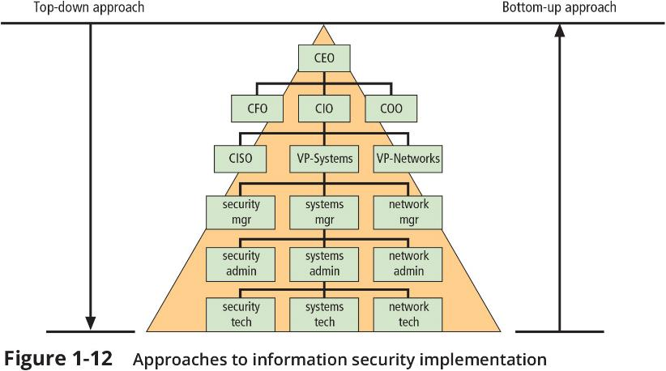
Approaches to Information Security Implementation
Notes:
The key concept here is the direction of the left and right side arrows to show where planning is sourced and from which direction the pressure for success is driven.

Slide 37
Security Professionals and the Organization
A wide range of professionals are required to support a diverse information security program.
Senior management support is the key component.
Additional administrative support and technical expertise are required to implement details of an IS program.
Notes:
It takes a wide range of professionals to support a diverse information security program.
To develop and execute specific security policies and procedures, additional administrative support and technical expertise is required.

Slide 38

Senior Management
Chief information officer (CIO)‏
Senior technology officer
Primarily responsible for advising the senior executives (CEO) on strategic planning that affects the management of information in the organization
Chief information security officer (CISO)‏
Has primary responsibility for assessment, management, and implementation of InfoSec in the organization
Usually reports directly to the CIO
Notes:
Chief Information Officer—The senior technology officer, although other titles such as Vice President of Information, VP of information technology, and VP of systems may be used. The CIO is primarily responsible for advising the chief executive officer, president, or company owner on the strategic planning that affects the management of information in the organization.
Chief information security officer—The individual primarily responsible for the assessment, management, and implementation of securing the information in the organization. The CISO may also be referred to as the manager for security, the security administrator, or a similar title.

Slide 39
Knowledge Check Activity 2
What title is given to the person with primary responsibility for assessment, management, and implementation of InfoSec in the organization?
CIO
CISO
CEO
CFO

Slide 40
Knowledge Check Activity 2: Answer
What title is given to the person with primary responsibility for assessment, management, and implementation of InfoSec in the organization?
Answer: B. CISO, or chief information security officer
The CISO usually reports to the CIO. While in some organizations, the CISO could report to the Chief Financil Officer (CFO), that is not common.

Slide 41
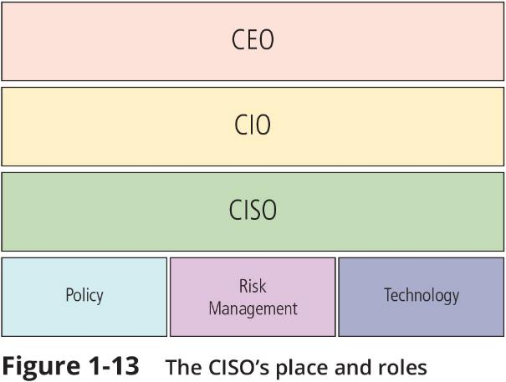
The CISO’s Place and Roles
Notes:
The key concept here is the direction of the left and right side arrows to show where planning is sourced and from which direction the pressure for success is driven.

Slide 42
Information Security Project Team
A small functional team of people who are experienced in one or multiple facets of required technical and nontechnical areas:
Champion
Team leader
Security policy developers
Risk assessment specialists
Security professionals
Systems administrators
End users
Notes:
A number of individuals who are experienced in one or multiple requirements of both the technical and nontechnical areas.
The champion: A senior executive who promotes the project and ensures its support, both financially and administratively, at the highest levels of the organization.
The team leader: A project manager, who may be a departmental line manager or staff unit manager, who understands project management, personnel management, and information security technical requirements.
Security policy developers: Individuals who understand the organizational culture, policies, and requirements for developing and implementing successful policies.
Risk assessment specialists: People who understand financial risk assessment techniques, the value of organizational assets, and the security methods to be used.
Security professionals: Dedicated, trained, and well-educated specialists in all aspects of information security from both technical and nontechnical standpoints.
Systems administrators: People with the primary responsibility for administering the systems that house the information used by the organization.
End users: Those whom the new system will most directly impact. Ideally, a selection of users from various departments, levels, and degrees of technical knowledge assist the team in focusing on the application of realistic controls applied in ways that do not disrupt the essential business activities they seek to safeguard.

Slide 43
Information Security Project Team
The champion: A senior executive who promotes (sponsors) the project and ensures its support, both financially and administratively, at the highest levels of the organization.
The team leader: A project manager, who may be a departmental line manager or staff unit manager, who understands project management, personnel management, and information security technical requirements.
Security policy developers: Individuals who understand the organizational culture, policies, and requirements for developing and implementing successful policies.

Slide 44
Information Security Project Team
Risk assessment specialists: People who understand financial risk assessment techniques, the value of organizational assets, and the security methods to be used.
Security professionals: Dedicated, trained, and well-educated specialists in all aspects of information security from both technical and nontechnical standpoints.
Systems administrators: People with the primary responsibility for administering the systems that house the information used by the organization.
End users: Those whom the new system will most directly impact. Ideally, a selection of users from various departments, levels, and degrees of technical knowledge assist the team in focusing on the application of realistic controls applied in ways that do not disrupt the essential business activities they seek to safeguard.

Slide 45

Data Responsibilities
Data owners: senior management responsible for the security and use of a particular set of information. The data owners work with subordinate managers to oversee the day-to-day administration of the data.
Data custodian: guardian responsible for information and systems that process, transmit, and store it. Depending on the size of the organization, this may be a dedicated position, such as the CISO, or it may be an additional responsibility of a systems administrator or other technology manager. The duties of a data custodian often include overseeing data storage and backups, implementing the specific procedures and policies laid out in the security policies and plans, and reporting to the data owner.
Notes:
Data owners: Members of senior management who are responsible for the security and use of a particular set of information. The data owners usually determine the level of data classification (discussed later), as well as the changes to that classification required by organizational change. The data owners work with subordinate managers to oversee the day-to-day administration of the data.
Data custodians: Working directly with data owners, data custodians are responsible for the information and the systems that process, transmit, and store it. Depending on the size of the organization, this may be a dedicated position, such as the CISO, or it may be an additional responsibility of a systems administrator or other technology manager. The duties of a data custodian often include overseeing data storage and backups, implementing the specific procedures and policies laid out in the security policies and plans, and reporting to the data owner.
Data users: Everyone in the organization is responsible for the security of data, so data users are included here as individuals with an information security role.

Slide 46

Data Responsibilities
Data trustees: appointed by data owners to oversee the management of a particular set of information and to coordinate with data custodians for its storage, protection, and use
Data users: have access to information and thus an information security role

Slide 47
Knowledge Check Activity 3
Which group in the organization is appointed by data owners to oversee the management of a particular set of information and to coordinate with data custodians for its storage, protection, and use?
Data owners
Data custodian
Data trustee
Data user

Slide 48
Knowledge Check Activity 3: Answer
Which group in the organization is appointed by data owners to oversee the management of a particular set of information and to coordinate with data custodians for its storage, protection, and use?
Answer: C. Data trustee
Only this selection is correct since data owners would not appoint themselves, data custodians are responsible for the infrastructure that supports information processing in general, and data users do not have the responsibilities listed.

Slide 49
Communities of Interest
Group of individuals united by similar interests/values within an organization
Information security management and professionals
Information technology management and professionals
Organizational management and professionals
Notes:
Each organization develops and maintains its own unique culture and values. Within that corporate culture, there are communities of interest. These include:
Information security management and professionals
Information technology management and professionals
Organizational management and professionals

Slide 50
Information Security: Is It an Art or a Science?
Implementation of information security is often described as a combination of art and science.
“Security artisan” idea: based on the way individuals perceive system technologists and their abilities
Security as art: no hard and fast rules nor many universally accepted complete solutions; no manual for implementing security through entire system
Security as science: technology is developed by scientists and engineers; specific conditions cause virtually all actions in computer systems; almost every security issue is a result of the interaction of specific hardware and software; with sufficient time, developers could resolve all faults.
Notes:
With the level of complexity in today’s information systems, the implementation of information security has often been described as a combination of art and science.
The concept of the security artisan is based on the way individuals perceived systems technologists since computers became commonplace.

Slide 51
Security as a Social Science
Social science examines the behavior of individuals interacting with systems.
Security begins and ends with the people that interact with the system, intentionally or otherwise.
End users that need the very information the security personnel are trying to protect may be the weakest link in the security chain.
By understanding some of the behavioral aspects of organizational science and change management, security administrators can greatly reduce the levels of risk caused by end users and create more acceptable and supportable security profiles.
Notes:
There is a third view: security as a social science.
Social science examines the behavior of individuals as they interact with systems, whether societal systems or, in our case, information systems.
Security begins and ends with the people inside the organization and the people that interact with the system, planned or otherwise.
End users that need the very information the security personnel are trying to protect may be the weakest link in the security chain.
By understanding some of the behavioral aspects of organizational science and change management, security administrators can greatly reduce the levels of risk caused by end users and create more acceptable and supportable security profiles.

Slide 52
Summary (1 of 4)
Information security evolved from the early field of computer security.
Security is protection from danger. There are many types of security: physical security, personal security, operations security, communications security, national security, and network security, to name a few.
Information security is the protection of information assets that use, store, or transmit information through the application of policy, education, and technology.
The critical characteristics of information, including confidentiality, integrity, and availability (the C.I.A. triad), must be protected at all times. This protection is implemented by multiple measures that include policies, education, training and awareness, and technology.

Slide 53
Summary (2 of 4)
Information systems are made up of the major components of hardware, software, data, people, procedures, and networks.
Upper management drives the top-down approach to security implementation, in contrast with the bottom-up approach or grassroots effort, in which individuals choose security implementation strategies.

Slide 54
Summary (3 of 4)
The control and use of data in the organization is accomplished by the following parties:
Data owners, who are responsible for the security and use of a particular set of information
Data custodians, who are responsible for the storage, maintenance, and protection of the information
Data trustees, who are appointed by data owners to oversee the management of a particular set of information and to coordinate with data custodians for its storage, protection, and use
Data users, who work with the information to perform their daily jobs and support the mission of the organization

Slide 55
Summary (4 of 4)
Each organization has a culture in which communities of interest are united by similar values and share common objectives. The three communities in information security are general management, IT management, and information security management.
Information security has been described as both an art and a science, and it comprises many aspects of social science as well.

Slide 56
Self-Assessment
What is information security?
How has the concept of security for the use of computer systems changed over time?
Information has many characteristics. What are the most critical of these characteristics that need to be kept secure?

